Slide 1



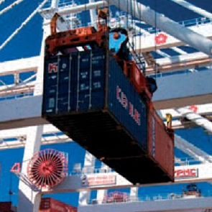


THE GLOBAL ACCREDITATION SYSTEM
The ILAC and IAF Handbook

Slide 2


Contents
Global Vision
IAF & ILAC
  Common Aims
  Quality Infrastructure
  The Arrangements
  Objectives
About IAF
  IAF Structure
  IAF Committees
  Coverage of the IAF MLA
  Status of the IAF MLA
About ILAC
  ILAC Structure
  ILAC Committees
  Coverage of the ILAC MRA
  Status of the ILAC MRA
IAF/ILAC Timeline
IAF & ILAC Multilateral MRAs
  Benefits
The Route to Signing the Arrangements
Application of the Global Accreditation System
Documents and Publications
Membership Types
ILAC Partners
IAF Partners
How Do the Committees Work?
Obligations as an AB?
World Accreditation Day
Sources of Further Information
Contact Details
© ILAC and IAF 2020

Slide 3
Global Vision
VISION:
Accredited once accepted everywhere
MISSION:
To be the global solution for the national, regional and international demonstration of equivalence of reliable results from testing, calibration, inspection and related activities in both voluntary and mandatory fields/sectors.
VISION:
Accreditation makes the world better.
MISSION:
IAF facilitates trade and supports sustainable development using internationally recognized accredited conformity assessment to deliver the confidence needed for market acceptance of goods and services.

Slide 4
Common Aims of IAF and ILAC
Support conformity assessment schemes which reduces risk for businesses, regulators and the consumer by ensuring that accredited services can be relied upon
Government and regulators relying on the Arrangements to further develop or enhance trade agreements
To support world trade by eliminating technical barriers, realising the free-trade goal of ‘tested, inspected or certified once and accepted everywhere’

Slide 5
Quality Infrastructure
Quality Infrastructure is the system comprising the organisations, the policies, relevant legal and regulatory framework, and practices needed to support and enhance the quality, safety and environmental soundness of goods, services and processes.
Utilising standards, metrology, accreditation and conformity assessment, this framework, supported by multilateral mutual recognition arrangements, has a positive impact on trade in the developed world and unlocks the trading potential of developing economies.

Slide 6
The IAF and ILAC Arrangements
Accreditation body members deemed competent through a peer evaluation process
  ISO/IEC 17011
  IAF-ILAC ‘A Series’ documents
Signatories must recognise certificates, reports and results issued as well as reference materials produced and proficiency testing programs provided by organisations accredited by other signatories
Provides businesses with assurance that overseas bodies operate to the same standard
Removes technical barriers to trade by eliminating redundant conformity assessment

Slide 7
IAF and ILAC Objectives
IAF and ILAC are global networks of accreditation bodies and organisations involved in conformity assessment activities. Objectives include:
Maintain the Arrangements, and expand coverage into new economies
Increase cooperation with all relevant stakeholders
Act as a central ‘hub’ to harmonise conformity assessment best practice
Provide assistance to developing countries by providing appropriate support to new accreditation activities

Slide 8
About IAF
IAF is a global association of Conformity Assessment Accreditation Bodies and other bodies interested in conformity assessment in the fields of management systems, products, services, persons, validation and verification and other similar programmes of conformity assessment.
Its main purpose is to operate and maintain a global Multilateral Recognition Arrangement (the IAF MLA) that enables the mutual recognition of certificates issued by conformity assessment bodies accredited by signatories to the IAF MLA, in order to provide recognised conformity assessment activities and global acceptance of conformity assessment certificates.
IAF also provides training, develops documentation (where required) to promote common accreditation practices, and a forum for sharing best practice.

Slide 9
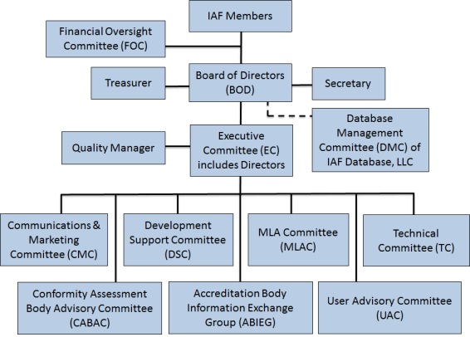
IAF Structure

Slide 10
IAF Structure
The highest level of authority in IAF is the Members, who make decisions and lay down policies in Annual Meetings or via ballots (Section 3.02 of the IAF Bylaws).
The Board is responsible for legal actions, for developing broad policy directions for IAF, and for ensuring that the day-to-day work of IAF is carried out in accordance with policies approved by Members.
The Executive Committee is responsible to the Board for the day-to-day work of IAF on the basis of decisions made by the Members and directions by the Board.
IAF Members
Board of Directors (BOD)
Executive Committee (EC) (includes Directors)

Slide 11
IAF Main Committees
MLA Committee (MLAC) - Responsible for the implementation and maintenance of the IAF arrangement
Development Support Committee (DSC) - Responsible for representing the interests of developing countries and operates in conjunction with the International Laboratory Accreditation Cooperation (ILAC)
Technical Committee (TC) - Coordinates the work of its Working Groups and Task Forces and addresses technical matters
Communications & Marketing Committee (CMC)
  Handles the discussion, development and coordination of any matter related to communications and marketing activities at the global and regional levels
  Raise the awareness, lift the profile and improve the image of accreditation at global, regional and national levels.
See IAF PL 5 for the Terms of Reference for all these Committees and Subcommittees with responsibilities and scopes of work

Slide 12
Coverage of the IAF MLA (June 2020)
IAF MLA Signatories
IAF Members not yet Signatories
Notes:
12

Slide 13
Status of the IAF MLA (June 2020)
There are 74 IAF MLA AB Signatories in the following main scope and sub-scope areas:
Main Scope:
  Management systems
  Product
  Persons
  Validation and Verification
  GHG Validation and Verification
Sub Scope Level 4:
  Global G.A.P. IFA General Regulations
  ISO/TS 22003 FSMS
  ISO/IEC 27006 ISMS
  ISO/IEC 17021-3 QMS
  ISO/IEC 17021-2 EMS
  ISO 50003 EnMS
  ISO/IEC TS 17021-10 OH&SMS
Sub Scope Level 5:
  ISO 9001 QMS
  ISO 14001 EMS
  ISO 22000 FSMS
  ISO/IEC 27001 ISMS
  Global G.A.P. IFA CPCCs
  FAMI-QS Certification Scheme
  ISO 13485 MDMS
  ISO 50001 EnMS
  IPC-PL-11-006
  ISO 45001 OH&SMS
Applications are being accepted for the above and the following scopes: ICAO CORSIA Version 1

Slide 14

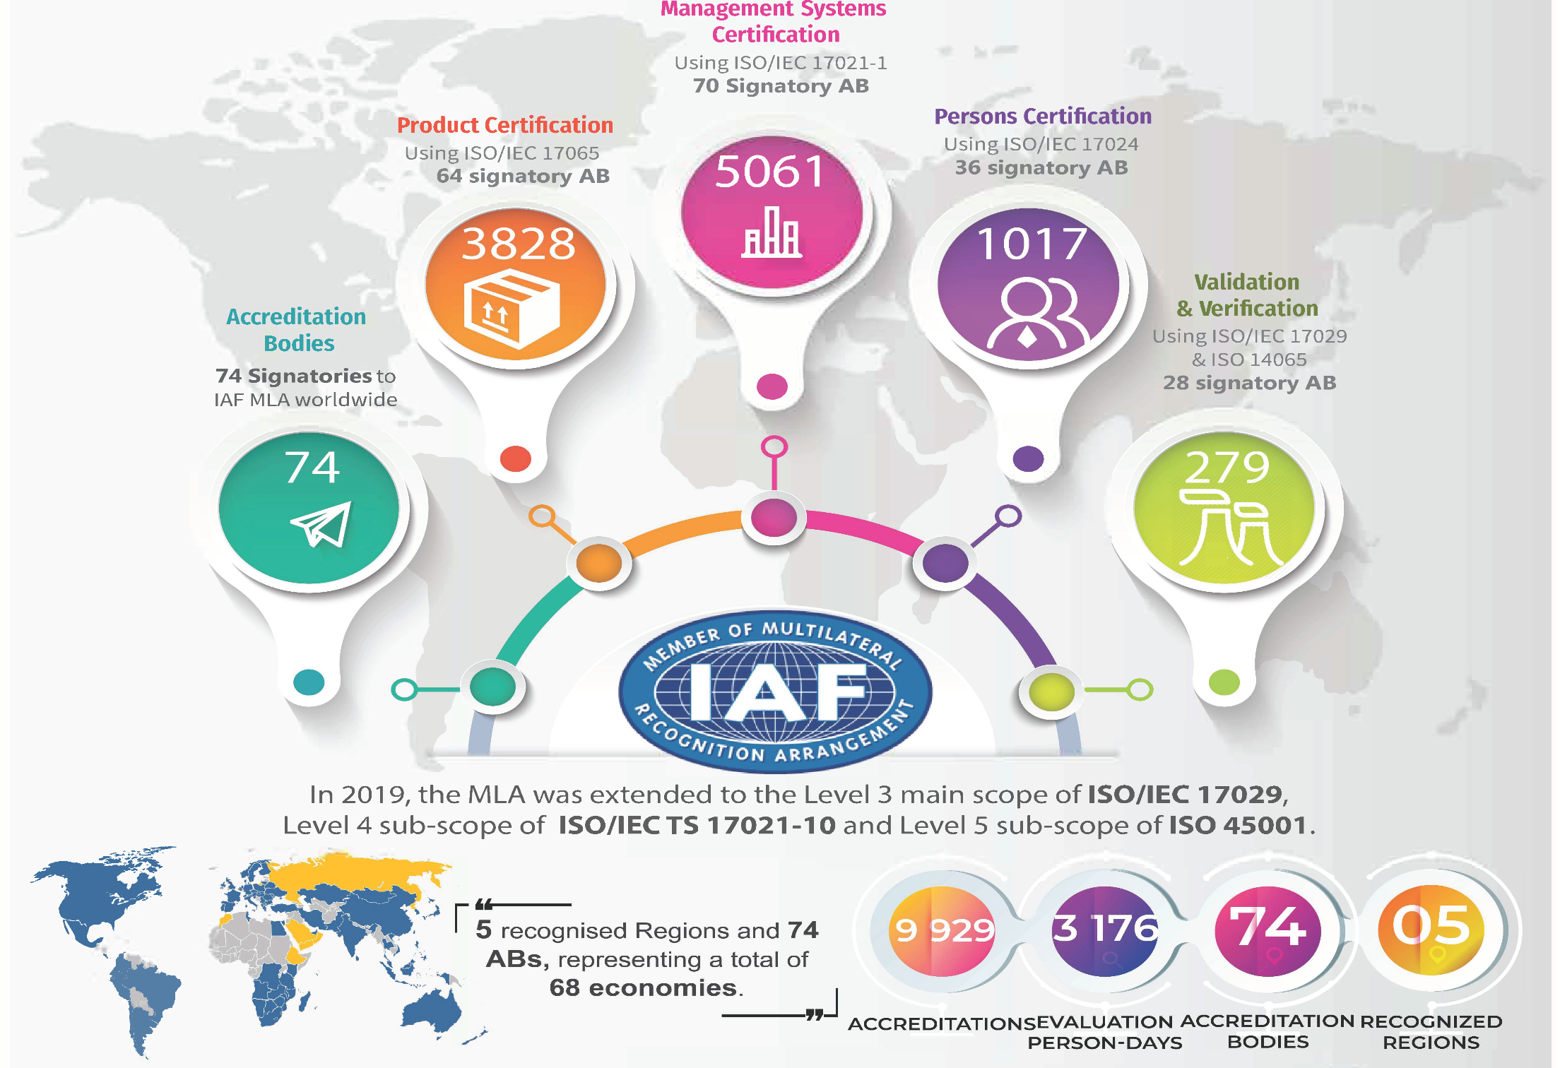

Slide 15
About ILAC
ILAC is the international authority on laboratory, inspection, reference material producer and proficiency testing provider accreditation with a membership consisting of accreditation bodies and affiliated organisations through out the world.
ILAC promotes the increased global use and acceptance by industry and government, of the results from accredited laboratories and inspection bodies, proficiency testing programs from accredited proficiency testing providers and reference materials produced by accredited reference material producers.
ILAC operates and manages the multi-lateral, mutual recognition arrangement (the ILAC MRA) to promote the acceptance of accredited test, calibration and inspection data and results, proficiency testing providers and reference material producers.

Slide 16
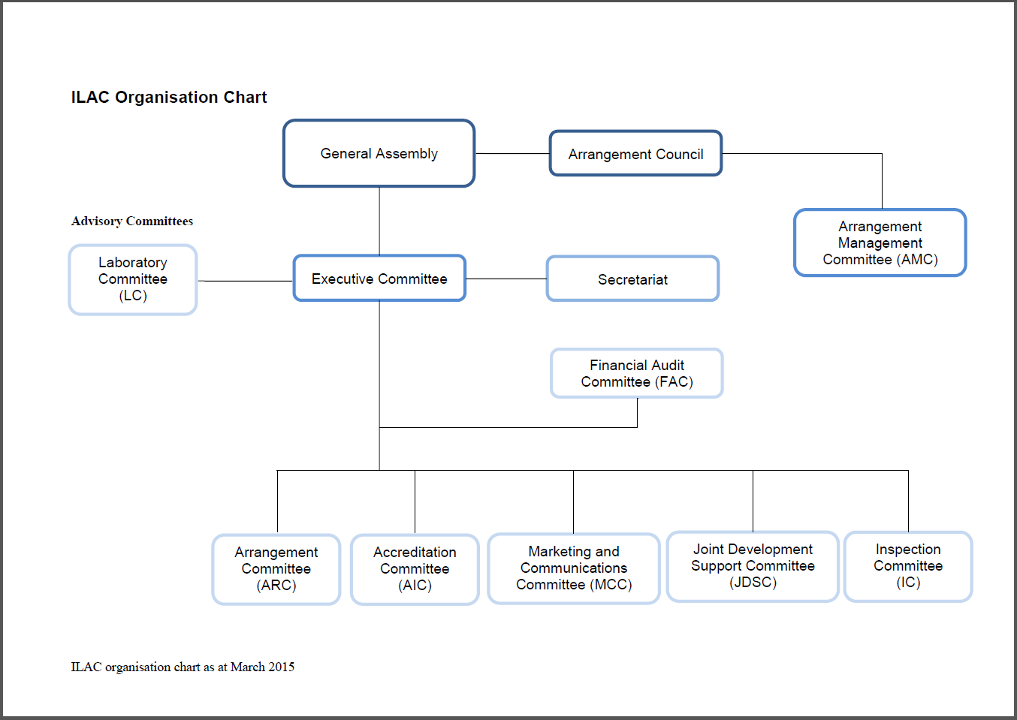
ILAC Structure
The General Assembly (GA) primary body of ILAC and ensures that specific tasks are pursued in accordance with the objectives of ILAC. All members of ILAC are eligible to nominate one representative.
Arrangement
Council
Accreditation
Committee
Inspection
Committee
Further information on the ILAC structure is available on the ILAC website

Slide 17
ILAC Committees
Executive Committee (EC) - Responsible for the day to day management of ILAC and its activities.
Arrangement Council - is the decision making body for determining signatory and recognition status under the ILAC MRA. The members are delegates nominated by the Full and Associate members.
The Arrangement Management Committee (AMC) - is responsible for the day-to-day management activities of the ILAC MRA on behalf of the Arrangement Council and provides advice on its further development and operation. This committee operates in-conjunction with the IAF MLA Management Committee for all joint ILAC/IAF evaluation related activities.
Arrangement Committee (ARC) - Responsible for harmonized implementation and continual improvement of the ILAC Arrangement

Slide 18
ILAC Committees (cont’d)
Accreditation Committee (AIC) - Responsible for harmonisation and improvement of accreditation practice at the international level.
Laboratory Committee (LC) - is a stakeholder group that provides a means of interaction and exchange of ideas between ILAC and the laboratory community.
Marketing and Communications Committee (MCC) - Responsible for internal and external marketing and communication issues. It is involved with the promotion of ILAC's objectives, and the publication of ILAC documents, newsletters and other information. This committee operates in-conjunction with the IAF Communications and Marketing Committee.

Slide 19
ILAC Committees (cont’d)
Joint Development Support Committee (JDSC) - Responsible for representing the interests of developing countries and operates in conjunction with the International Accreditation Forum (IAF).
Inspection Committee (IC) - Responsible for the harmonisation and improvement of accreditation practices for inspection activities at the international level.

Slide 20
Coverage of the ILAC MRA (15 April 2020)
ILAC MRA Signatories
ILAC Associate Members
ILAC Affiliate Members

Slide 21
Status of the ILAC MRA (20 August 2020)
The ILAC network of members includes 153 bodies from 128 different economies (101 Full Members/MRA Signatories, 14 Associates, 9 Affiliates, 23 Stakeholders, 6 Regional Cooperation Bodies)
101 ILAC MRA Signatories representing 104 economies
ILAC MRA covers testing, calibration, inspection, proficiency testing providers and reference material producers
Signatories represent about 95% of Global GDP
Almost 76,500 accredited laboratories
Over 10,500 accredited inspection bodies
Over 400 accredited proficiency testing providers
Over 30 reference materials producers

Slide 22
IAF / ILAC Timeline
2001 1st Joint IAF-ILAC General Assembly
2000 ILAC MRA
Testing & Calibration
2012 ILAC MRA Inspection
2020 ILAC
MRA Reference
Material Producers
1977 – ILAC established
2019 ILAC MRA Proficiency Testing Providers
1996 – ILAC
MOU
2003 - ILAC Incorporated
1995 –
IAF MOU
1998 IAF MLA Management Systems
IAF Bylaws
IAF Incorporated
2007 IAF MLA
Persons
1993 – IAF established
2014 IAF MLA
Validation &
Verification
2004 IAF MLA Product

Slide 23




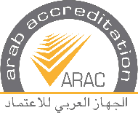
IAF/ILAC Multilateral MRAs
European Cooperation
for
Accreditation (EA)
Inter-American
Accreditation Cooperation
(IAAC)
Asia Pacific
Accreditation Cooperation
(APAC)
Southern African
Development
Community Accreditation
(SADCA)
African Accreditation Cooperation (AFRAC)
Arab Accreditation Cooperation (ARAC)
A laboratory, inspection body, certification body, proficiency testing provider or reference material producer accredited by one partner has equivalent competence to a laboratory, inspection body, certification body, proficiency testing provider or reference material producer accredited by the other partner(s).
The structure of the global accreditation system is divided into two levels: the regional level (EA, ARAC, APAC, SADCA, AFRAC and IAAC) and the global level (ILAC and IAF).
The IAF MLA recognises AFRAC, APAC, ARAC, EA and IAAC
The ILAC MRA recognises AFRAC , APAC, ARAC, EA and IAAC

Slide 24
IAF/ILAC Multilateral MRAs (cont’d)
Accreditation bodies in the major parts of the world are both members of a region and of the global associations.
Exceptions are accreditation bodies from parts of the world, where a regional cooperation is not established yet; those accreditation bodies are only members of the global associations (unaffiliated bodies).
Stakeholders and other interested parties may also be members of the global associations.
Recognition of a region is achieved after successful peer evaluation by ILAC or IAF.
ILAC and IAF rely on the evaluations undertaken by the recognised regions to grant and maintain signatory status for the accreditation bodies.

Slide 25
The Benefits of the IAF/ILAC Multilateral MLAs/MRAs
  For Government
  Facilitator of trade
  An efficient enforcement and monitoring tool
  For Business
  Greater acceptance of products and services
  Avoid costs associated with repeat conformity assessment
  Informed procurement
  For Consumers
  Public confidence in goods and services
  Minimises product failures or recalls

Slide 26
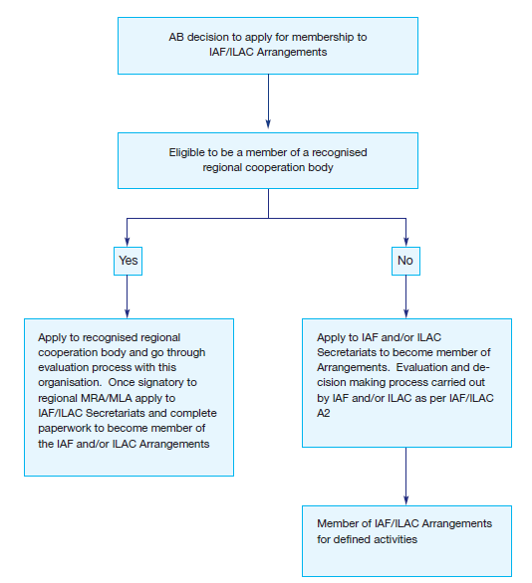
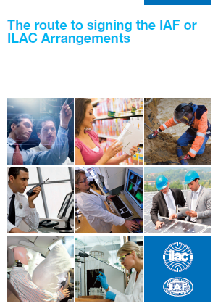
The Route to signing the Arrangements

Slide 27
Application of the Global Accreditation System
www.publicsectorassurance.org was launched by ILAC, IAF, ISO, IEC AND IIOC to illustrate the value of accredited conformity assessment.
It enables government officials and regulators to access international case studies in policy areas, showcasing how different tools are able to deliver results
The site contains links to independent research, where conformity assessment is being used in policy areas such as:
  Economic development
  Healthcare
  Environmental protection
  Energy
  Food safety
  Construction
  Crime and security
There are also some good examples of the added value of Quality Infrastructure on business-benefits.org which includes case studies, research papers, and supporting materials that confirm these benefits for the business community.

Slide 28
Documents and Publications
Both organisations publish documents that set out the rules, policies and procedures that members must adhere to. Guidance and informative documents are also available to share best practice and ensure a common interpretation of accreditation practices.
Brochures (B Series)
General ILAC brochures or promotional publications
General Information and Promotional Documents
to raise awareness and understanding of IAF
Guidance (G Series)
The interpretation of accreditation criteria for specific
applications for accreditation bodies and accredited
organisations.
Policy Documents (PL Series)
IAF and Member policy requirements
MLA Documents (ML Series)
Policy and procedures to support the operation of the MLA
Rules (R Series) - Rules (Requirements)
Documents including the Articles and Bylaws and other
documents covering the operation of ILAC as an
incorporated entity.
Informative (ID Series)
To support the consistent application of requirements
Mandatory Documents (MD Series)
Mandatory documents to be used by ABs and CABs
Procedural (P Series)
Procedural and policy publications for the operation of the
ILAC Arrangement, and which form part of the criteria for
ILAC Arrangement evaluations.
Procedures Documents (PR Series)
Procedures to follow in implementing the IAF programs
Joint IAF / ILAC (A Series) –
Joint IAF and ILAC documents used for the evaluation of regions and unaffiliated bodies.

Slide 29
Membership Types
Full Members (Signatories)
Accreditation bodies that have been accepted as
signatories to the ILAC MRA, and abides by its terms and
conditions and by the ILAC evaluation procedures.
Accreditation Body Members
Accreditation Body that accredit bodies for certification
of management systems, products, services, personnel,
as well as for other programmes of conformity assessment.
Accreditation body members must declare their intention
to join the IAF MLA.
Associates
Accreditation bodies not yet signatories to the ILAC MRA, that carry out accreditation of conformity assessment that is officially recognised in that economy.
Association Members
Organisations involved in the use or implementation of
certification systems.
Affiliates
Accreditation bodies that are currently operating, being developed, or intended to be developed.
Regional Accreditation Groups
Regional groupings of Accreditation Bodies whose aims
include the maintenance of Regional Multilateral
Recognition Arrangements recognising the equivalence of
their members' accreditations.
Regional Cooperation Bodies
Formally established regional cooperations having objectives similar to and compatible with ILAC, which are committed to the obligations of the ILAC MRA and which consist of at least four economies.
Stakeholders
Representative international, regional and national organizations having an interest in the work of ILAC
Observer Organisations

Slide 30













ILAC Partners
  International Accreditation Forum
International Organization of Legal Metrology
World Anti-Doping Agency
International Electrotechnical Commission
International Federation for Clinical Chemistry
International Organisation for Standardisation
UN Industrial Development Organisation
International Committee on Weights & Measures
International Telecommunications Union
International Halal Accreditation Forum
World Bank
INetQI
ILAC liaises and cooperates with many international bodies such as MoU partners to achieve shared objectives.

Slide 31








IAF Partners
IAF works with a number of organisations and cooperates with many international bodies, including numerous MoU partners, to achieve shared objectives.
International Laboratory Accreditation Cooperation
International Organisation for Standardisation
International Organization of Legal Metrology
International Electrotechnical Commission
UN Industrial Development Organisation
International Halal Accreditation Forum
International Personnel Certification Association
World Bank
The Global Food Safety Initiative
GLOBALG.A.P.
The Quality and Safety System for Specialty Feed Ingredients
International Civil Aviation
Organization
International Telecommunications Union
INetQI

Slide 32
How do the Committees Work?
Committees, Subcommittees, Working Groups, and Task Forces typically meet once or twice a year, in conjunction with the Mid-Term Meetings of IAF and ILAC and the Annual meetings.
When discussing issues and documents, the goal is a consensus approach, but, at times, formal voting is required.
Voting may be in person at meetings or by letter-ballot.
The decisions and agreements reached during meetings are recorded in either Minutes or for the Annual Meetings as Resolutions.

Slide 33
What are my Obligations as an AB?
Participating in Annual Meetings and Committees
All members are able and encouraged to join, participate and contribute to the work of ILAC and IAF. This can be done by attending meetings or by email correspondence.
Task Forces are generally set up to complete a particular task and are disbanded on completion.
Working Groups are generally discussion groups in a particular area.
Active participation and contribution to the work of IAF and ILAC in the Mid-Term and Annual Meetings
Promoting the MRA / MLA
All members are obliged to support the acceptance of the Arrangements.

Slide 34
What are my Obligations as an AB? (cont’d)
Voting
Voting may be conducted at the meetings, or by email, or electronically.
ILAC and IAF members have an obligation to vote in a timely manner for documents that are circulated for letter-ballot.
You will receive a notification of each ballot and deadlines by email and in most cases will be required to vote online, on the Members side of the websites.
Failure to submit the required number of ballots within a 12 month period may lead to sanctions.
Peer evaluators
ILAC and IAF welcome volunteers to be trained as peer evaluators.

Slide 35
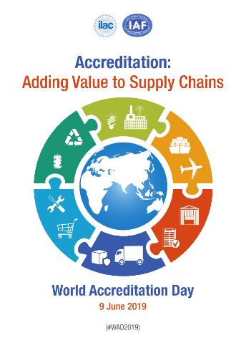


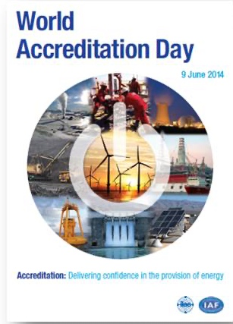
World Accreditation Day
World Accreditation Day takes place on 9th June each year. A theme is agreed by the Joint Executives, and materials are available from the ILAC and IAF websites to support promotion in your economy. Major conferences, events, workshops, and press campaigns take place in over 90 economies.
World Accreditation Day 2020 (#WAD2020)
Accreditation: Improving Food Safety

Slide 36
Sources of Further Information
To remain up-to-date with developments, the following sources of information are available:
ILAC News and IAF Outlook – published twice a year.
http://ilac.org/news-and-events/ilac-newsletter/
http://www.iaf.nu/articles/IAF_Newsletter/164
ILAC and IAF Intranets – The members only areas of the websites contain valuable information for members, including access to meeting papers, ballots, technical documents, guidance notes, and promotional tools. Contact the Secretariats for access.
Subscribe to the latest IAF updates – https://bit.ly/2SdgR4x
Subscribe to the latest ILAC updates – http://ilac.org/latest_ilac_news/
ILAC and IAF Publications – a wide range of publications are available to download from:
  http://ilac.org/publications-and-resources/
  http://iaf.nu/articles/Publications/6/
Annual Reports – ILAC and IAF publish an Annual report each year that sets out the key developments and status of the MRA / MLA.

Slide 37

Contact Details
The IAF Secretariat
Phone: +1 (613) 454 8159
Email: Secretary@iaf.nu
The ILAC Secretariat
Phone: +61 2 9736 8374
Email: ilac@nata.com.au
https://twitter.com/IAF_Global
https://twitter.com/ILAC_Official
https://www.linkedin.com/company/
international-accreditation-forum-inc/
https://www.youtube.com/
user/IAFandILAC
https://www.youtube.com/
user/IAFandILAC

